Slide 1


Power-Efficient 16×8 SRAM Array Design and Layout Implementation using a Low-Power 7T SRAM Cell
ECE-C, GROUP – C2
Bibhu asish panda (2201209613)
S Nitish (2201209701)
Chandan Shaw (2201209619)
Abhisek Jena (2101209403)
ECE-C, GROUP – C2
Bibhu asish panda (2201209613)
S Nitish (2201209701)
Chandan Shaw (2201209619)
Abhisek Jena (2101209403)
GUIDED BY :
Mr. Dhananjaya Tripathy
Mr.
(Professor)
GUIDED BY :
Mr. Dhananjaya Tripathy
Mr.
(Asst. Professor)
Branch-Electronics and Communication Engineering
Department of Electronics Engineering
Silicon University, Odisha
Bhubaneswar-751024

Slide 2

CONTENTS
Introduction
Literature Survey
Problem Statement
Proposed Techniques
Conclusions
References

Slide 3
INTRODUCTION
SRAM is a high-speed volatile memory widely used in microprocessors, cache memories, and embedded systems.
It stores data using bistable circuits formed by cross-coupled inverters, allowing fast read and write operations.
A typical SRAM system consists of the SRAM cell Array and peripheral circuits such as Row Decoder, Precharge circuit, Write Driver, and Sense Amplifier.
With technology scaling, SRAM design faces challenges such as reduced stability, read disturbance, and increased power consumption. To address these issues, optimized SRAM architectures and efficient peripheral circuits are required.
In this work, a 16×8 SRAM memory array is designed using 180 nm CMOS technology in Cadence Virtuoso with XFAB PDK, and its circuit blocks are analyzed and verified through simulation.

Slide 4
LITERATURE SURVEY
Author / Reference | Year | Work | Key Contribution
E. Seevinck et al. | 1987 | Static Noise Margin Analysis of SRAM Cells | Introduced the butterfly curve method for evaluating SRAM stability using SNM.
Sung-Mo Kang & Yusuf Leblebici | 2003 | CMOS Digital Integrated Circuits: Analysis and Design | Explained SRAM cell operation, transistor sizing, and memory architecture design.
N. Weste & D. Harris | 2011 | CMOS VLSI Design | Discussed SRAM architecture and peripheral circuit design challenges in modern CMOS technology.
B. Razavi | 2012 | Design of Analog CMOS Integrated Circuits | Provided insights into sense amplifier and differential circuit design used in memory systems.
Y. Zhang et al. | 2010 | Modified SRAM Cell Architectures | Demonstrated that 7T SRAM cells improve stability and reduce leakage compared to 6T cells.

Slide 5
PROBLEM STATEMENT
Conventional 6T SRAM cells suffer from reduced stability and reliability as CMOS technology scales down.
During read operation, stored data may get disturbed due to direct connection between storage nodes and bitlines.
Small voltage difference developed on bitlines (BL and BLB) during read operations makes data sensing difficult.
Increasing transistor leakage and power consumption also affect overall memory efficiency.
In addition to the SRAM cell, efficient peripheral circuits such as row decoder, precharge circuit, write driver, and sense amplifier are required for reliable memory operation.
Therefore, there is a need to design an optimized SRAM architecture with improved stability, reduced power consumption, and reliable read/write operations.

Slide 6
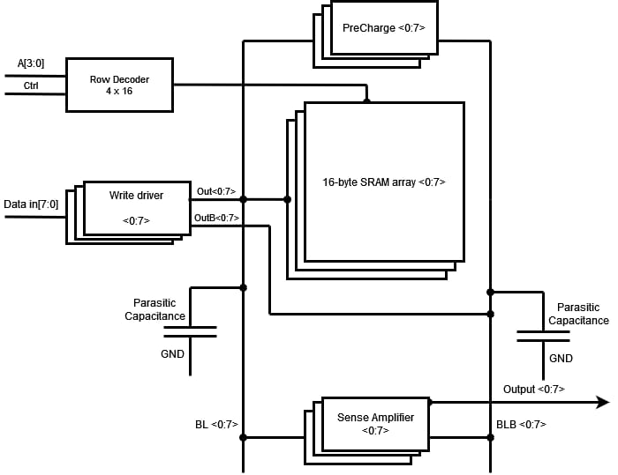
SRAM System Architecture
Designed a 16 × 8 SRAM array (128-bit or 16byte memory) using 180 nm CMOS technology in Cadence Virtuoso.
The SRAM system consists of a cell array and peripheral circuits for read/write operations.
Main Blocks -
SRAM Cell Array – stores binary data using SRAM cells.
Row Decoder – converts 4-bit address into 16 wordlines.
Bitlines (BL / BLB) – used for read and write operations.
Precharge Circuit – charges bitlines to VDD before read.
Write Driver – writes input data onto bitlines.
Sense Amplifier – detects small voltage differences during read.
Fig. 1 SRAM system architecture

Slide 7
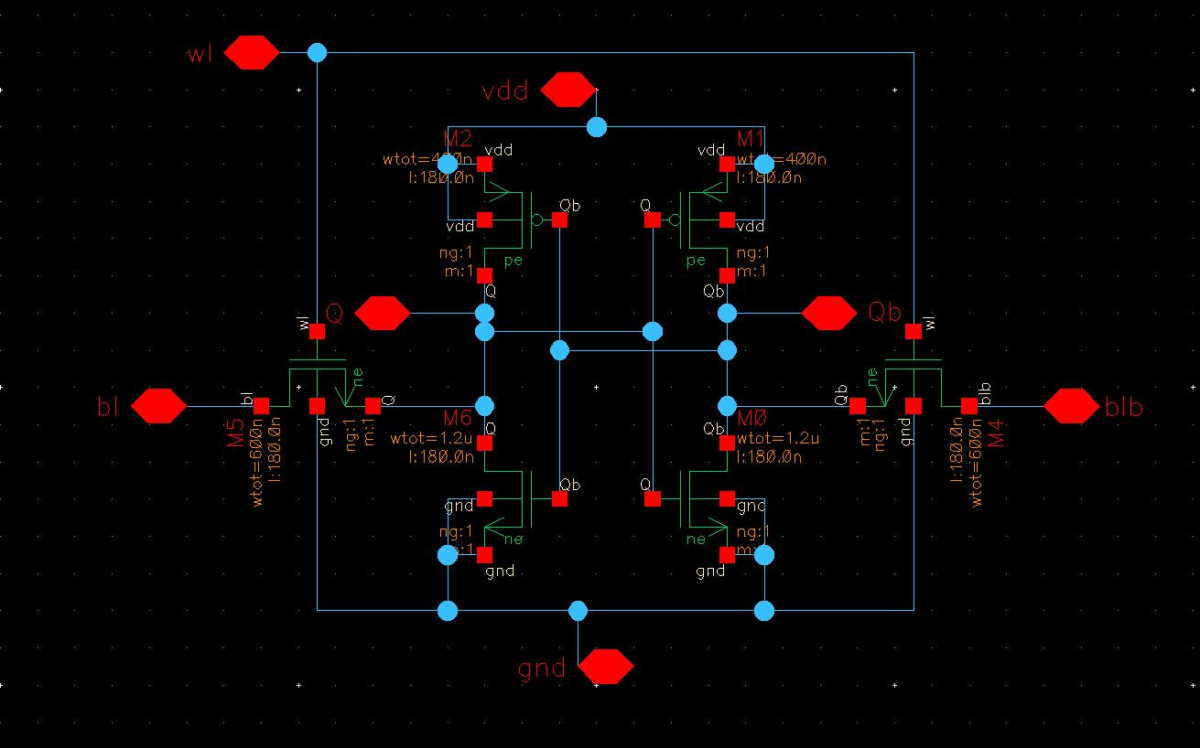
6T SRAM Cell Design
Conventional SRAM cell composed of 6 transistors.
Two cross-coupled inverters store one bit of data at nodes Q and QB.
Access transistors controlled by Wordline (WL) connect the cell to BL and BLB.
Basic Operations
1. Hold: WL = 0, stored data maintained 2. Read: WL = 1, data sensed through bitlines 3. Write: WL = 1, write driver forces new data into the cell.
Fig 2. 6T-SRAM schematic design

Slide 8
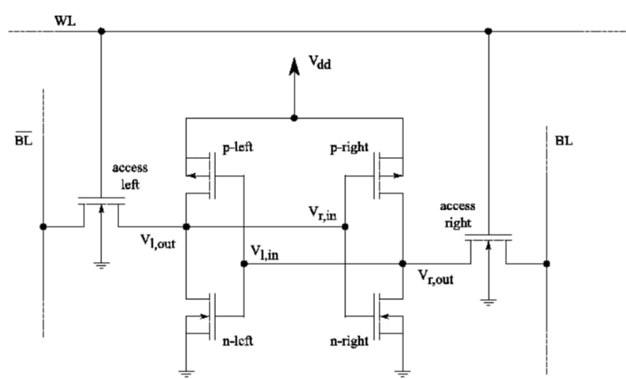



Transistor Sizing Methodology
Proper transistor sizing ensures read stability and write stability in SRAM cells.
Design Conditions – &
(where $W_{PD}$is width of Pull-down transistors (NMOS), $W_{AX}$is width of axial transistors (NMOS) and $W_{PU}$ is width of Pull-up transistors)
Sizing Rule - Pull-down NMOS > Access NMOS > Pull-up PMOS
(Example sizing used: PD = 1.2 µm, AX = 600 nm, PU = 400 nm)
$$CR=\frac{W_{PD}}{W_{AX}}>1.5$$
$$PR=\frac{W_{AX}}{W_{PU}}>1$$
Fig. 3 SRAM sizing

Slide 9
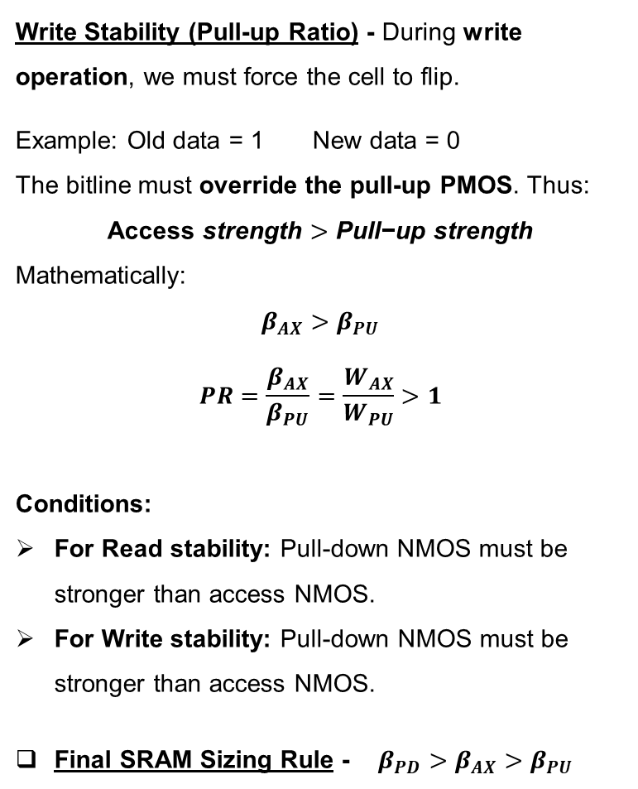
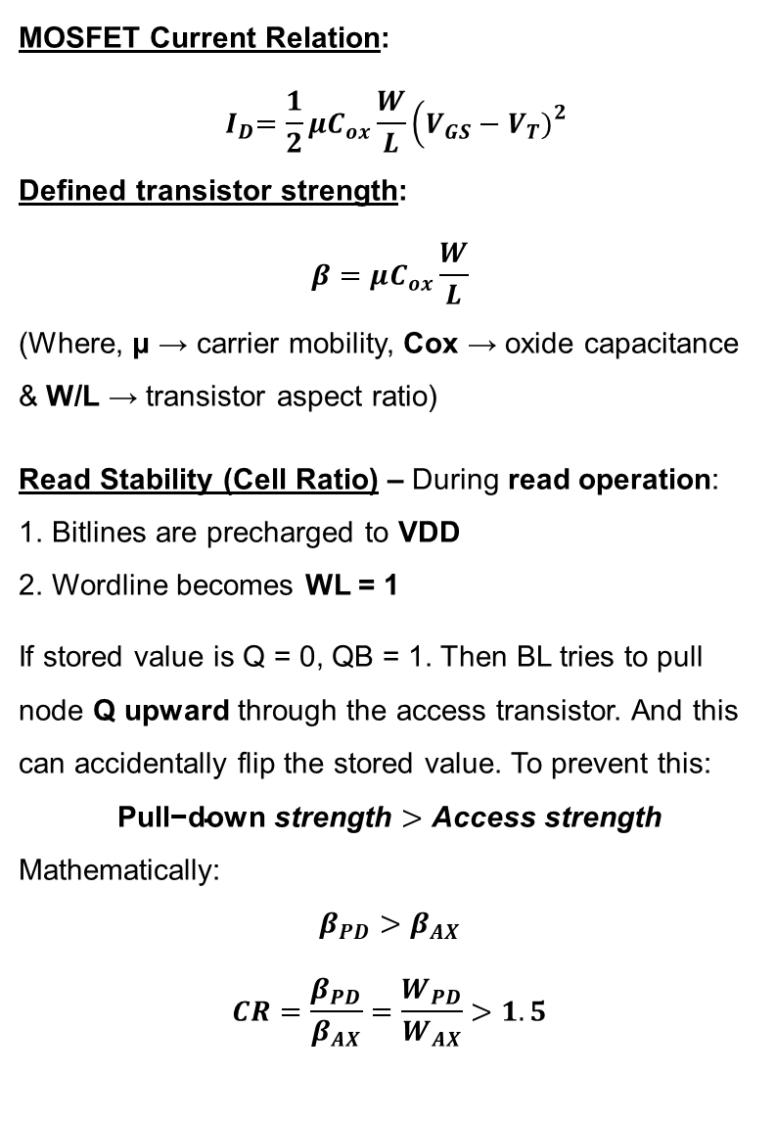
MOSFET Current Relation:
$${ I}_{D}=\frac{1}{2}μC_{ox}\frac{W}{L}\left(V_{GS}−V_{T}{\left.)\right.}^{2}\right.$$
Defined transistor strength:
$$β=μC_{ox}\frac{W}{L}$$
(Where, μ → carrier mobility, Cox → oxide capacitance & W/L → transistor aspect ratio)
Read Stability (Cell Ratio) – During read operation:
1. Bitlines are precharged to VDD
2. Wordline becomes WL = 1
If stored value is Q = 0, QB = 1. Then BL tries to pull node Q upward through the access transistor. And this can accidentally flip the stored value. To prevent this:
$$\text{Pull}\text{−}\text{down} \text{strength}>\text{Access} \text{strength}$$
Mathematically:
$$β_{PD}>β_{AX}$$
$$CR=\frac{β_{PD}}{β_{AX}}=\frac{W_{PD}}{W_{AX}}>1.5$$
Write Stability (Pull-up Ratio) - During write operation, we must force the cell to flip.
Example: Old data = 1 New data = 0
The bitline must override the pull-up PMOS. Thus:
$$\text{Access} \text{strength}>\text{Pull}\text{−}\text{up} \text{strength}$$
Mathematically:
$$β_{AX}>β_{PU}$$
$$PR=\frac{β_{AX}}{β_{PU}}=\frac{W_{AX}}{W_{PU}}>1$$
Conditions:
For Read stability: Pull-down NMOS must be stronger than access NMOS.
For Write stability: Pull-down NMOS must be stronger than access NMOS.
Final SRAM Sizing Rule - $β_{PD}>β_{AX}>β_{PU}$

Slide 10
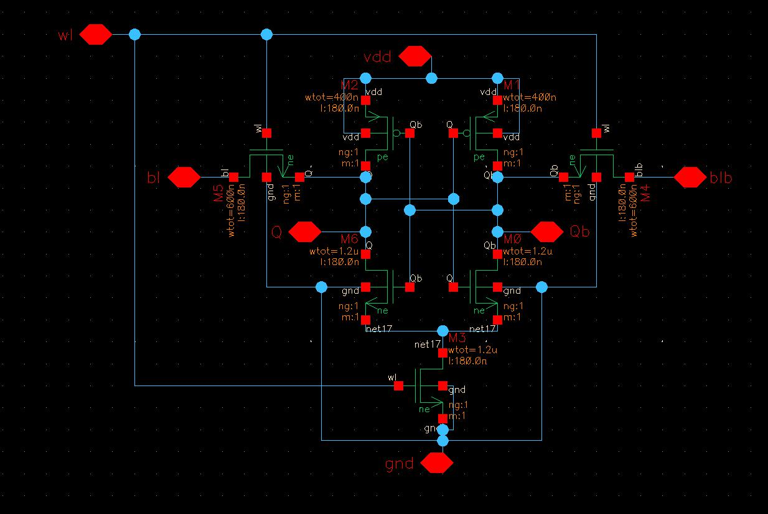
Proposed 7T SRAM Cell
One additional NMOS transistor is added
below the pull-down network of 6T SRAM cell.
Purpose of the Bottom Transistor
Reduces read disturbance at the storage node
Improves stability of the SRAM cell
Key Advantages
Higher Static Noise Margin (SNM)
Improved read stability
Better power efficiency
Additional Transistor Sizing – Bottom Access NMOS Width = 1.2 µm
Fig 4. Proposed 7T-SRAM schematic design

Slide 11

SRAM Functional Verification
performed using Cadence Virtuoso transient simulation
Write Operation
Bitlines forced externally (BL = data, BLB = data_bar). Wordline WL = 1 enables access transistors.
Cross-coupled inverters store the written data.
Read Operation
Bitlines precharged (BL = BLB = VDD). Wordline activated (WL = 1).
One bitline discharges depending on stored data.
Key topic: Subthreshold Leakage
When $V_{GS}<V_{TH}$, a small current still flows in MOSFET due to carrier diffusion called subthreshold leakage current.
$$I_{sub}=I_{0}e^{\frac{V_{GS}−V_{TH}}{nV_{T}}}$$
This current is In SRAM arrays, it contributes to standby power consumption and may affect data stability.
The 7T SRAM cell reduces leakage by introducing an additional transistor in the ground path.

Slide 12
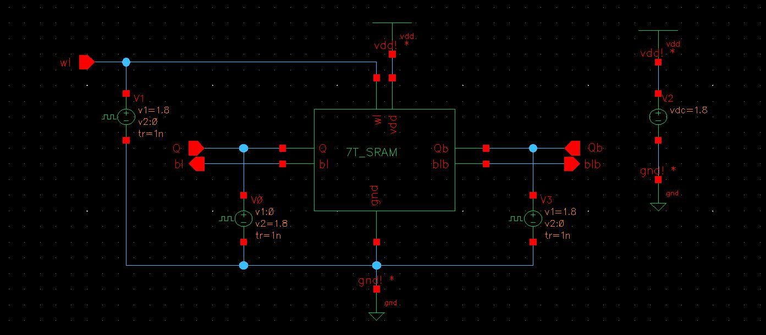
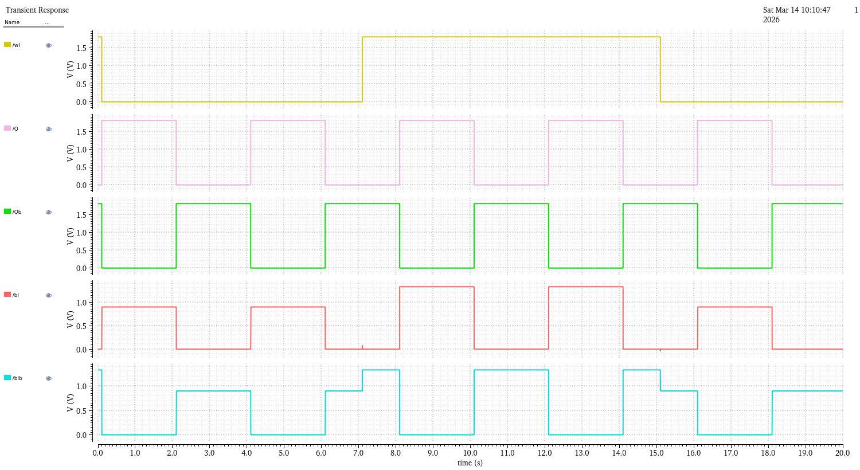
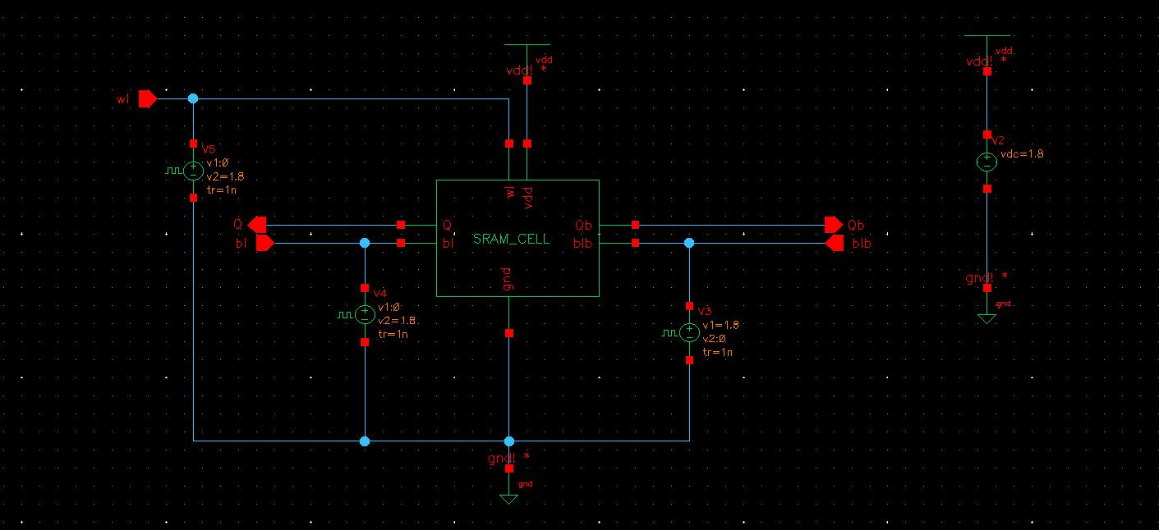
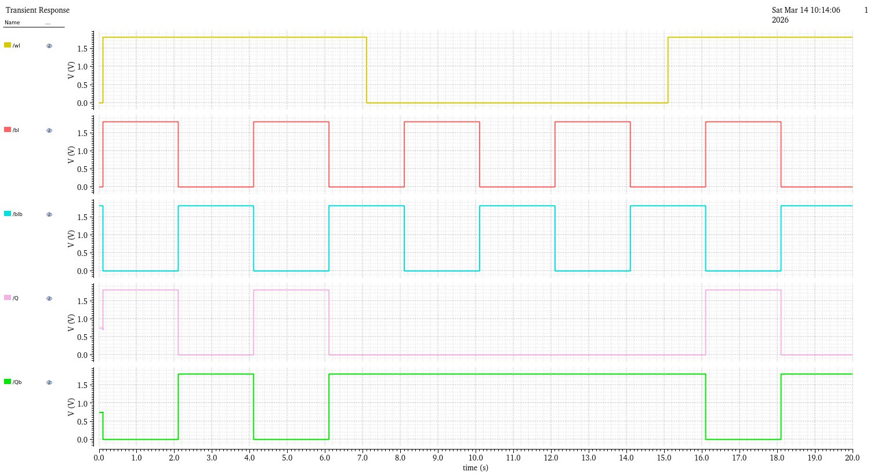
Read – Write test analysis observation
Fig 5. SRAM cell Read test
Fig 6. SRAM cell Read test
Fig 7. SRAM cell Write test
Fig 8. SRAM cell Write test

Slide 13
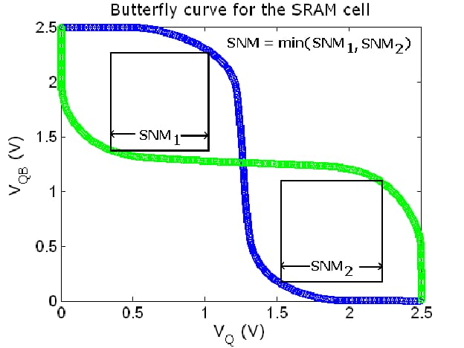

Stability Analysis using Butterfly Curve
Stability of SRAM evaluated using Static Noise Margin (SNM).
Butterfly curve obtained from DC simulation of cross-coupled inverters.
(SNM = side of the largest square inside the butterfly curve)
Observation
7T SRAM shows larger SNM compared to 6T SRAM.
Indicates better stability and reduced read disturbance.
Power & Leakage Observation
7T reduces leakage current due to controlled ground path.
Shows slightly lower power consumption during read operation.
Fig 9. SRAM butterfly curve

Slide 14
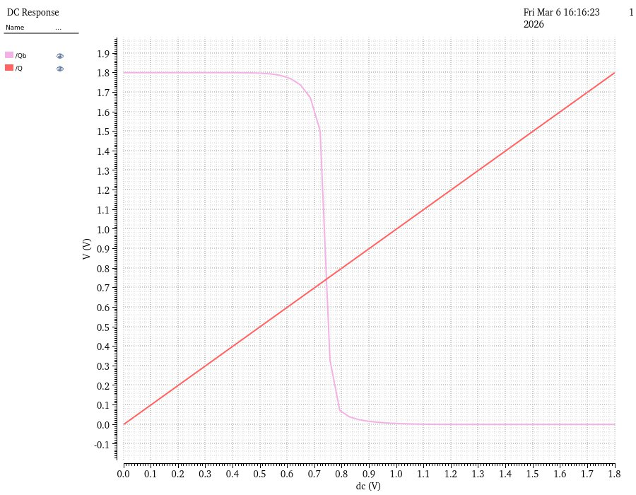
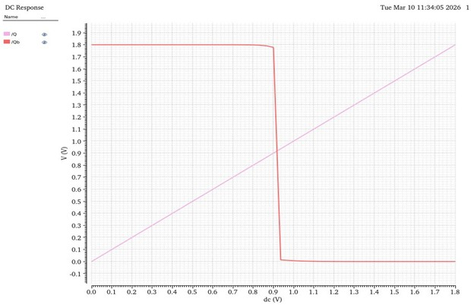
DC analysis and the VTC curve
Fig 10. 6T SRAM VTC curve
Fig 11. 6T SRAM VTC curve
SRAM | Supply Voltage (VDD) | Average Current | Average Power
6T SRAM | 1.8 V | 507.5 nA | 913.5 nW
7T SRAM | 1.8 V | 353.4 nA | 636.12 nW
Table 1. 6T vs 7T Average Power comparison (power consumption analysis)
Conclusion: Power consumption reduced by 30.36% in 7T compared to 6T SRAM.

Slide 15
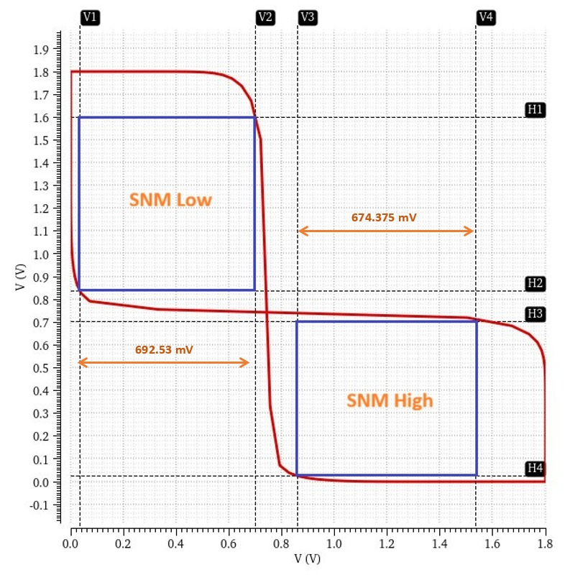
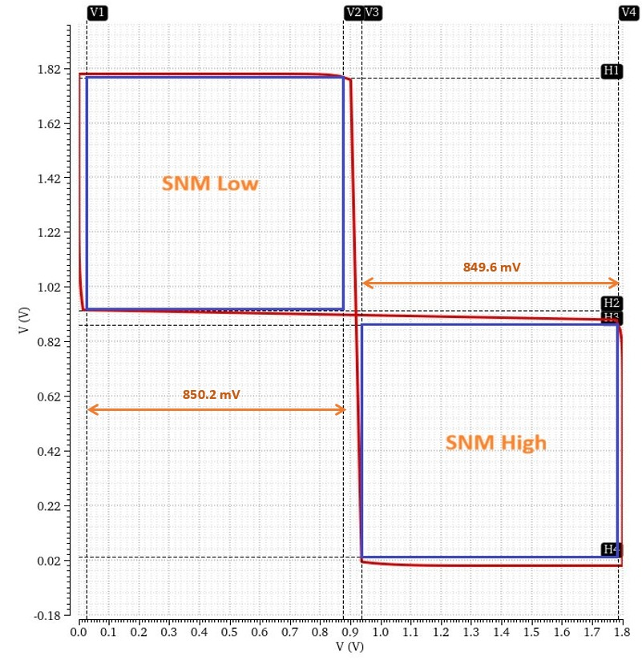
DC analysis and the Butterfly curve for Stability analysis
Fig 12. 6T SRAM butterfly curve
Fig 13. 6T SRAM butterfly curve
SRAM | SNML (mV) | SNMH (mV) | SNM = min(SNML,SNMH) (mV)
6T SRAM | 692.53 | 674.375 | 674.375
7T SRAM | 850.282 | 849.692 | 849.692
Table 2. 6T vs 7T SNM comparison (stability analysis)
Conclusion: SNM improved increased by 25.98% in 7T compared to 6T SRAM.

Slide 16
6T vs 7T Observed Comparison
Parameter | 6T SRAM Cell | Proposed 7T SRAM Cell
Number of Transistors | 6 transistors per cell | 7 transistors per cell
Cell Structure | Two cross-coupled inverters with two access transistors | Similar to 6T with an additional bottom NMOS transistor
Static Noise Margin (SNM) | Lower SNM because of read disturbance | Higher SNM due to reduced disturbance at storage node (around 26% higher than 6T)
Stability | Lower stability during read operation due to direct bitline interaction. And lower SNM. | Improved stability due to controlled ground path. And Higher SNM compared to 6T
Power Consumption | Higher power consumption during read operations | Lower power due to controlled discharge path (around 30.36% lesser than 6T)
Leakage Power | Higher leakage current in idle state | Reduced leakage due to additional transistor in ground path
Area Utilization | Smaller silicon area | Slightly larger area due to extra transistor

Slide 17
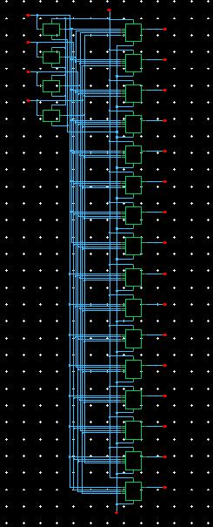
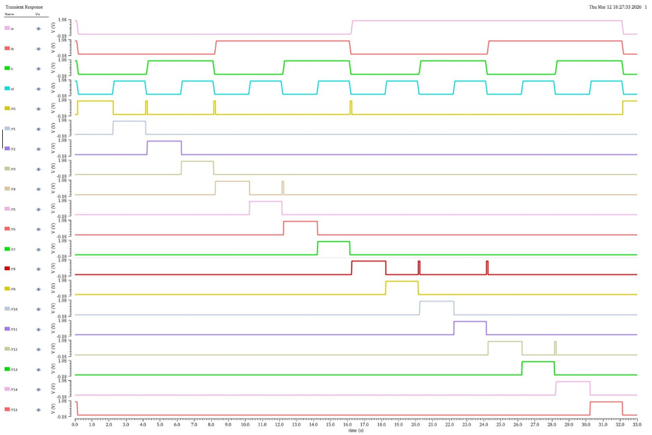

4×16 Row Decoder
Converts 4-bit address input into 16 wordlines(n $→2^{n} \text{outputs}\text{)}$
For this design: $2^{4}=16$
Implemented using input inverters and 4-input AND gates.
Each AND gate corresponds to one address combination and activates the respective wordline (WL).
Ensures only one row of SRAM cells is selected during read or write operation.
Fig 15. 4x16 Row decoder
Fig 16. Row decoder test

Slide 18
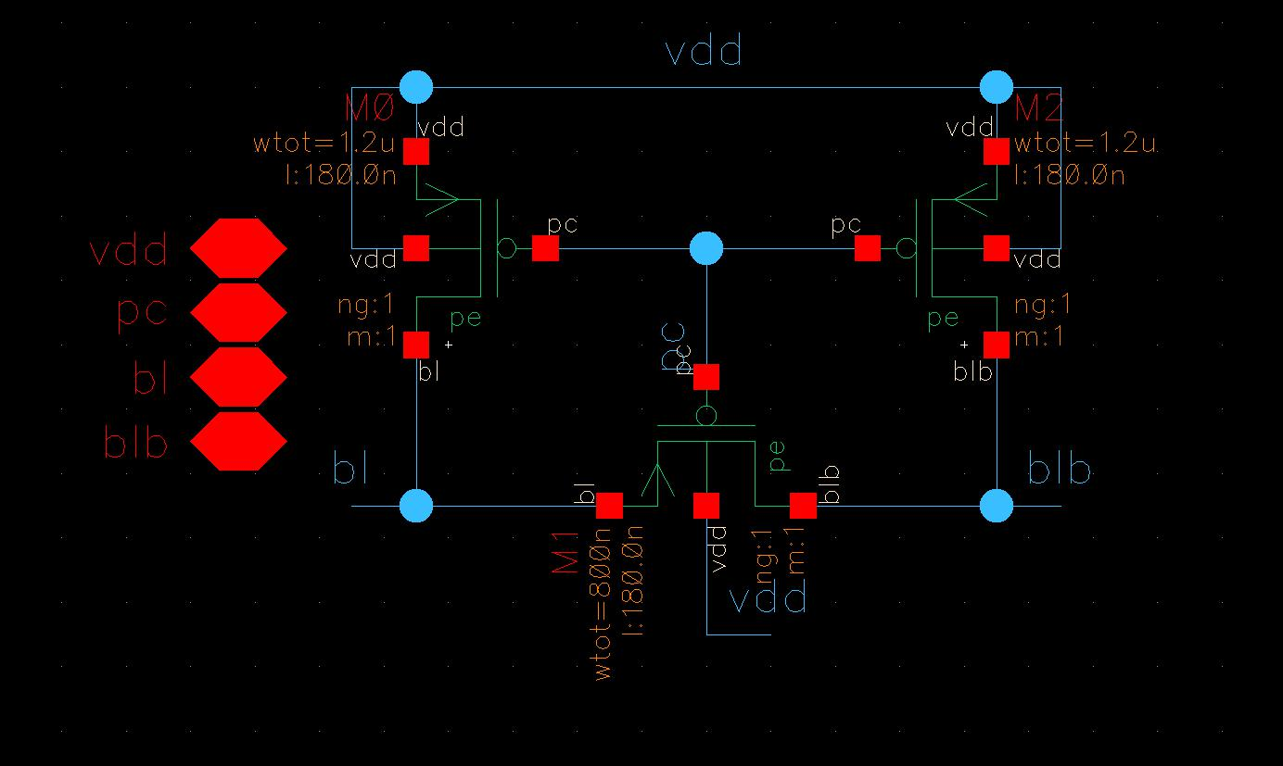
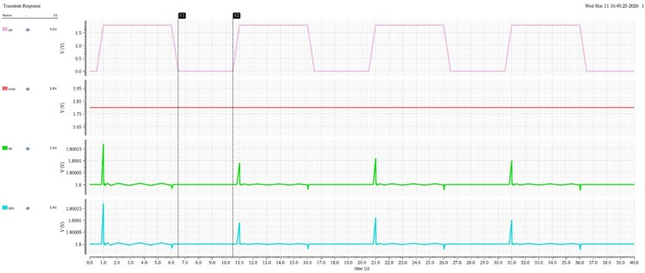
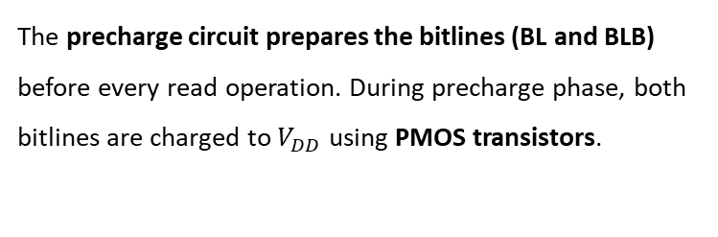
Precharge Cell
The precharge circuit prepares the bitlines (BL and BLB) before every read operation. During precharge phase, both bitlines are charged to $V_{DD}$ using PMOS transistors.
Operating Principle
When Precharge Enable = 0, PMOS transistors turn ON and BL and BLB charge to VDD.
When Precharge Enable = 1, PMOS transistors turn OFF and Bitlines become floating for read operation.
Purpose in SRAM
Ensures both bitlines start from the same voltage level.
Allows the sense amplifier to detect small voltage differences during read operation.
Fig 16. Precharge cell
Fig 17. Precharge circuit test

Slide 19
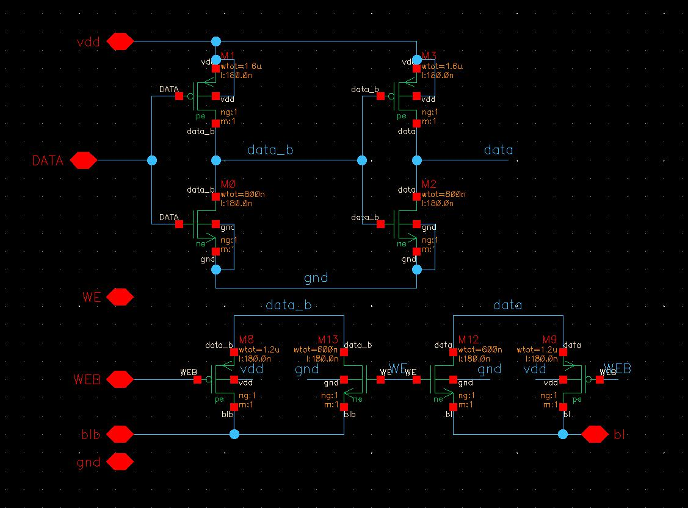
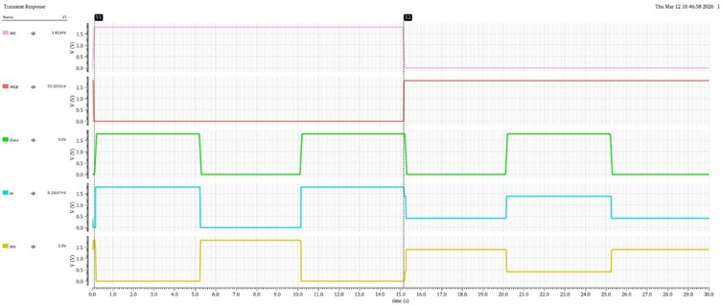

Write Driver Circuit
Forces the input data onto bitlines (BL and BLB) during write operation. Implemented using:
Two CMOS inverters (for inversion and buffering)
Transmission gates controlled by Write Enable (WE).
$$BL=Data \& BLB=Data_bar$$
Operating Principle
When WE = 1, Transmission gates turn ON,
Data is driven strongly onto BL and BLB.
When WE = 0, Transmission gates turn OFF,
Bitlines are isolated from the driver.
It strongly drives bitlines to overwrite the stored value in the SRAM cell.
Fig 18. Write driver
Fig 19. Write driver test

Slide 20
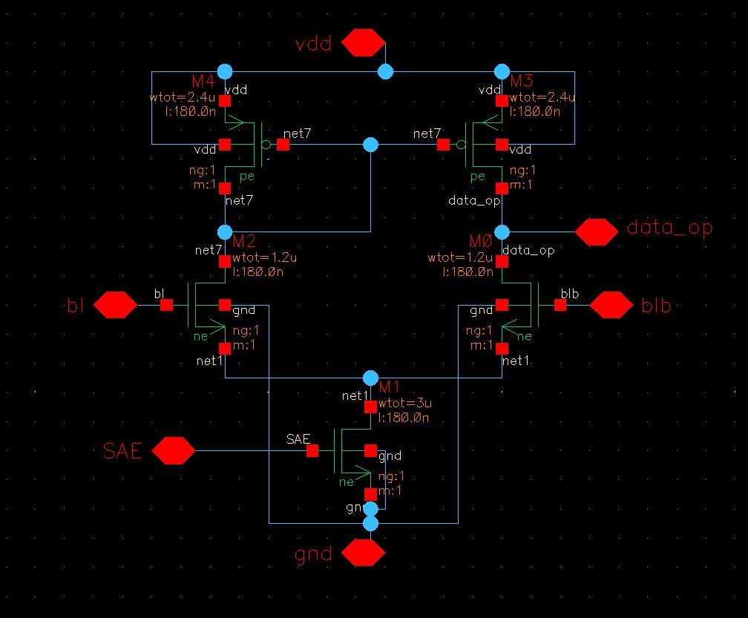
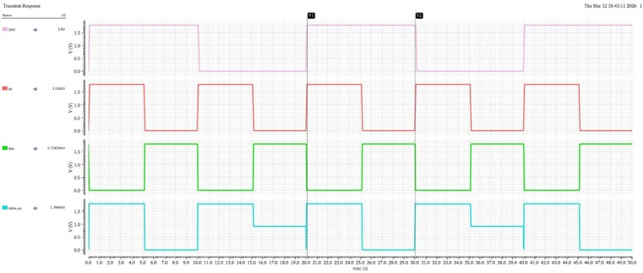
Sense Amplifier
Used to detect small voltage difference between BL and BLB during read operation.
Implemented as a differential amplifier.
Operation:
Bitlines initially precharged to VDD. During read, one bitline discharges slightly depending on stored data.
Sense Amplifier Enable (SAE) activates the circuit.
The small voltage difference is amplified into full logic output.
Purpose: Enables fast and reliable read operation in SRAM.
Fig 20. Sense amplifier
Fig 21. Sense Amplifier test

Slide 21
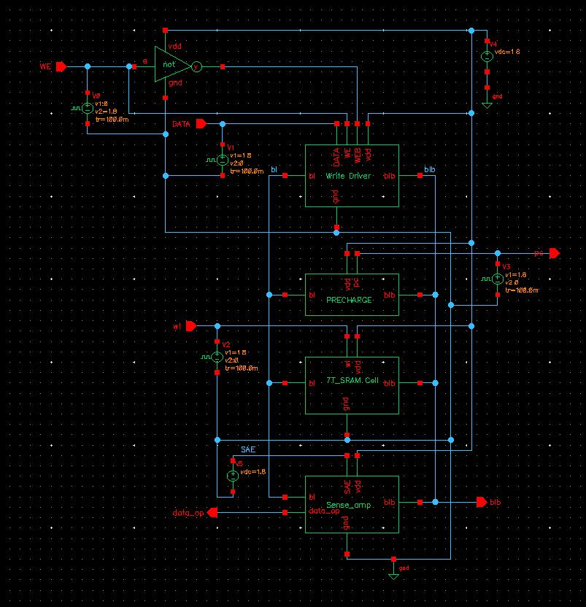

1-bit SRAM Architecture Analysis
When PC = 0, the precharge circuit charges both bitlines
$$BL=BLB=V_{DD}$$
When WE = 1, the write driver forces
$$BL=DATA, BLB=\overset{‾}{DATA}$$
Write Operation: When WE = 1 and WL = 1, the input data is written into the SRAM cell and stored at node Q.
Read Operation: When WE = 0 and WL = 1, both bitlines start at $V_{DD}$. Depending on stored data, one bitline discharges slightly.
Sense Amplifier detects the small voltage difference between BL and BLB and produces the amplified output.
Observation:
A small disturbance appears on the bitlines during read operation.
This is due to read disturb and charge sharing between the SRAM cell and bitlines, which is a normal behaviour in SRAM sensing.
Fig 22. Single SRAM cell Architecture

Slide 22
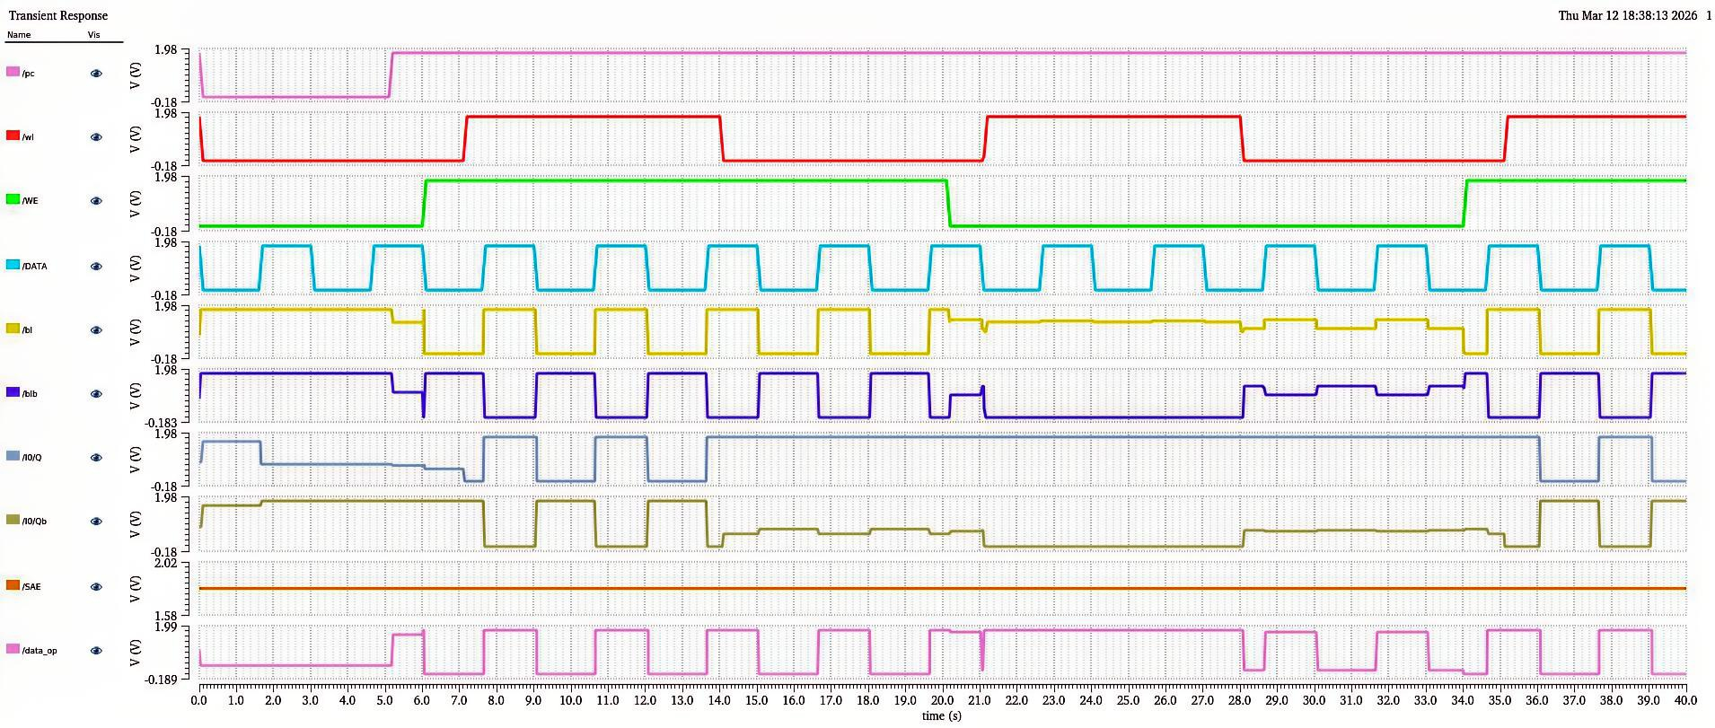
Fig 23. 1-bit 7T SRAM analysis waveform

Slide 23
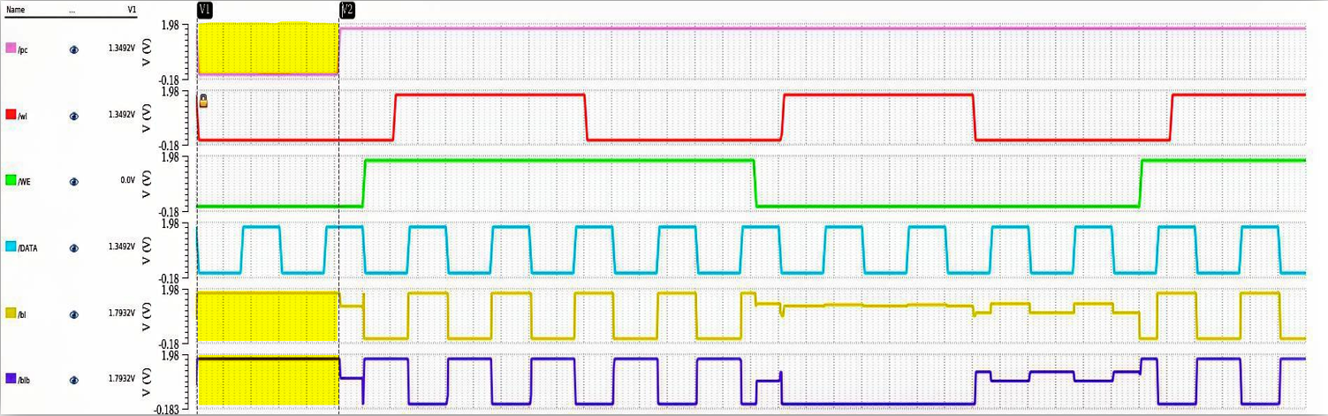
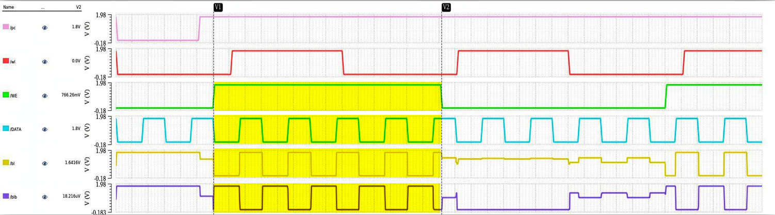
Fig 24. Precharge conditions
Fig 25. write enable condition

Slide 24
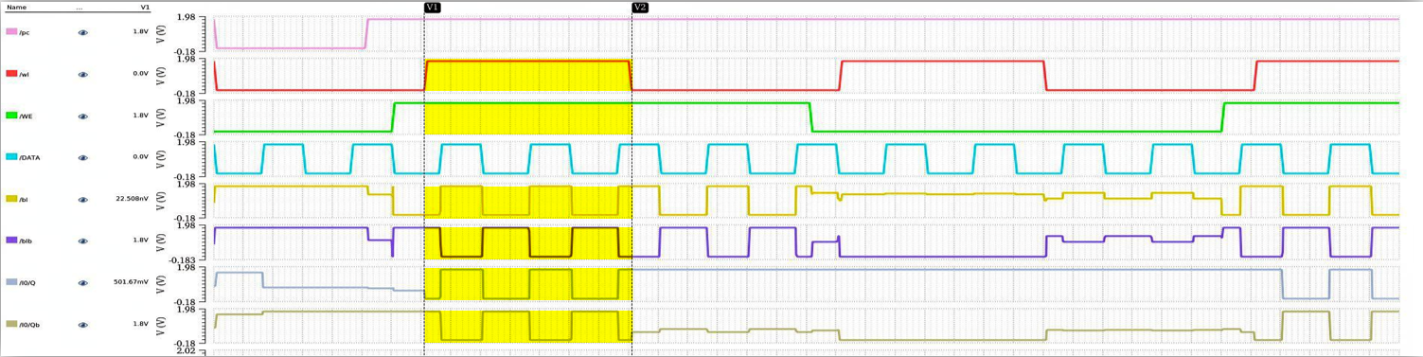
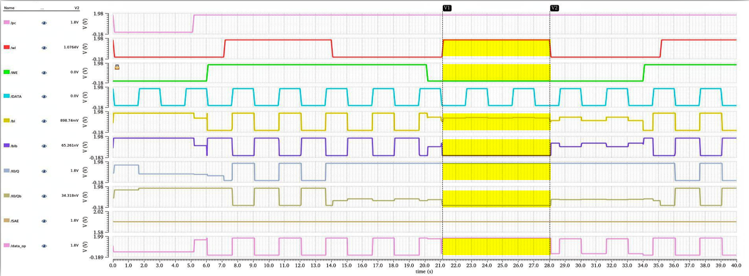
Fig 26. Write conditions
Fig 27. Read condition

Slide 25
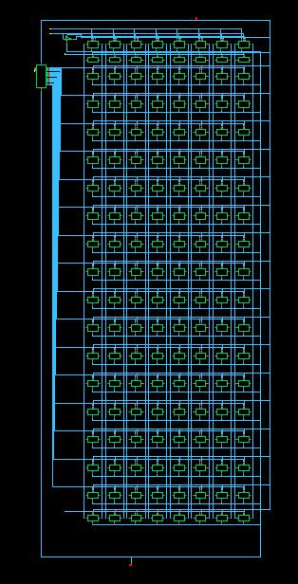
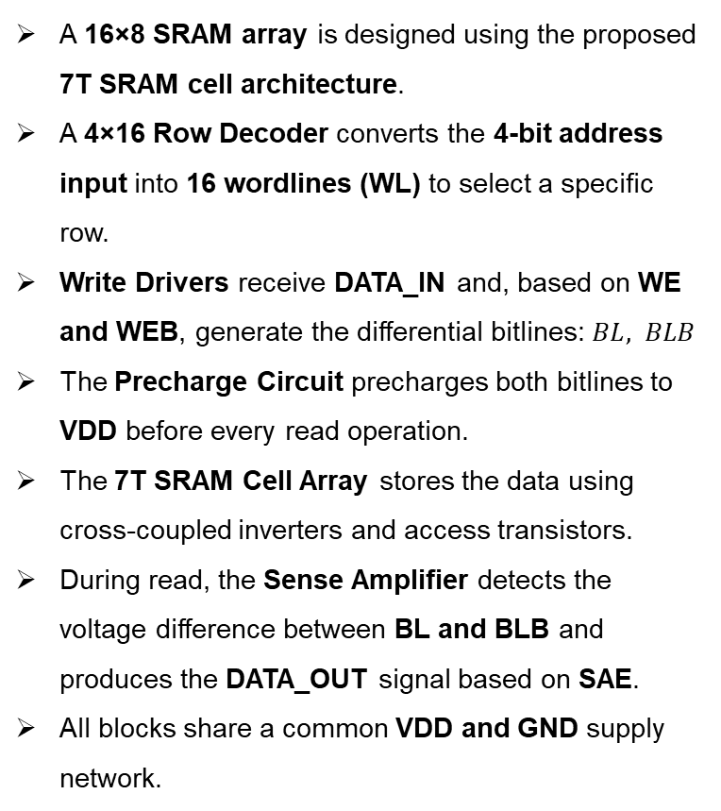
16×8 7T SRAM Array with all peripheral circuits
A 16×8 SRAM array is designed using the proposed 7T SRAM cell architecture.
A 4×16 Row Decoder converts the 4-bit address input into 16 wordlines (WL) to select a specific row.
Write Drivers receive DATA_IN and, based on WE and WEB, generate the differential bitlines: $BL, BLB$
The Precharge Circuit precharges both bitlines to VDD before every read operation.
The 7T SRAM Cell Array stores the data using cross-coupled inverters and access transistors.
During read, the Sense Amplifier detects the voltage difference between BL and BLB and produces the DATA_OUT signal based on SAE.
All blocks share a common VDD and GND supply network.
Fig 28. 16 × 8 7T SRAM Array with Peripheral Circuits

Slide 26

Layout Design
Layout implemented in Cadence Virtuoso using 180 nm XFAB PDK.
Physical realization of circuits using transistors, metal layers and interconnections.
Completed Layouts Designed:
CMOS Inverter
4-Input AND Gate
4×16 Row Decoder
7T – SRAM cell
Precharge cell
Verification
DRC (Design Rule Check) - Ensures layout follows fabrication design rules.
LVS (Layout vs Schematic) - $Layout=Schematic$ Confirms layout matches the circuit schematic.

Slide 27
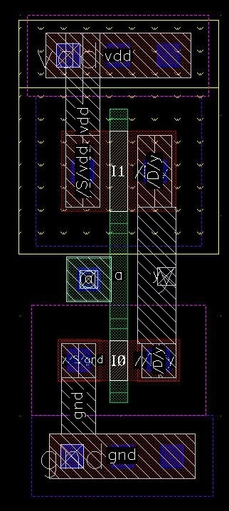
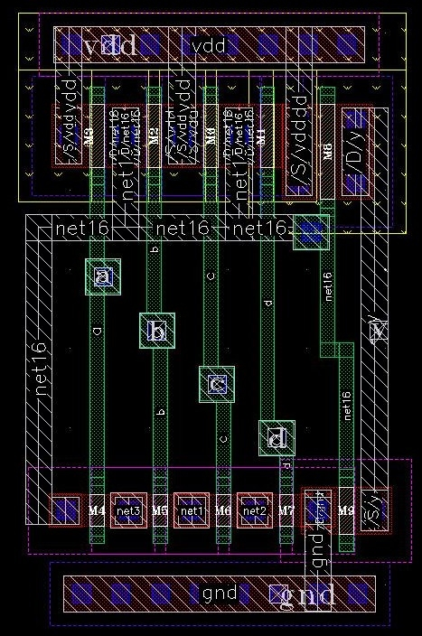
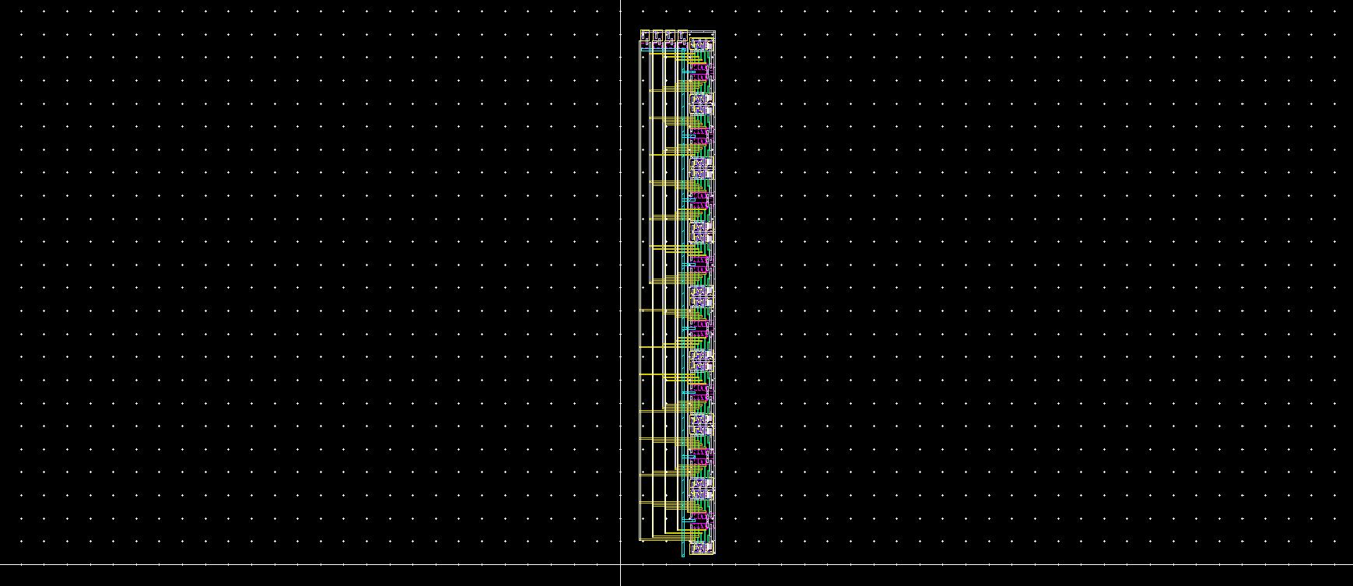
Fig 29. Inverter Layout
Fig 30. 4-input AND gate Layout
Fig 31. 4x16 Decoder Layout

Slide 28
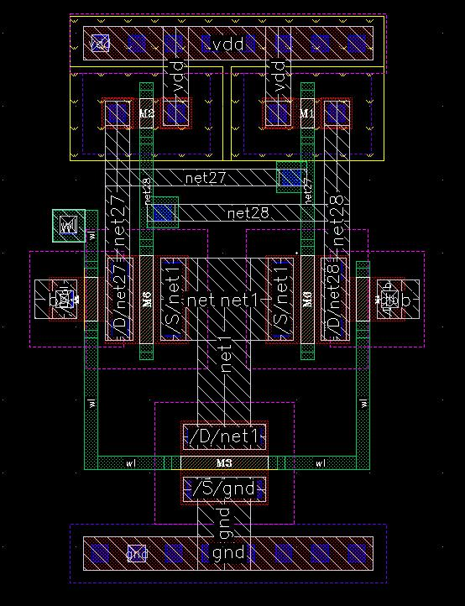
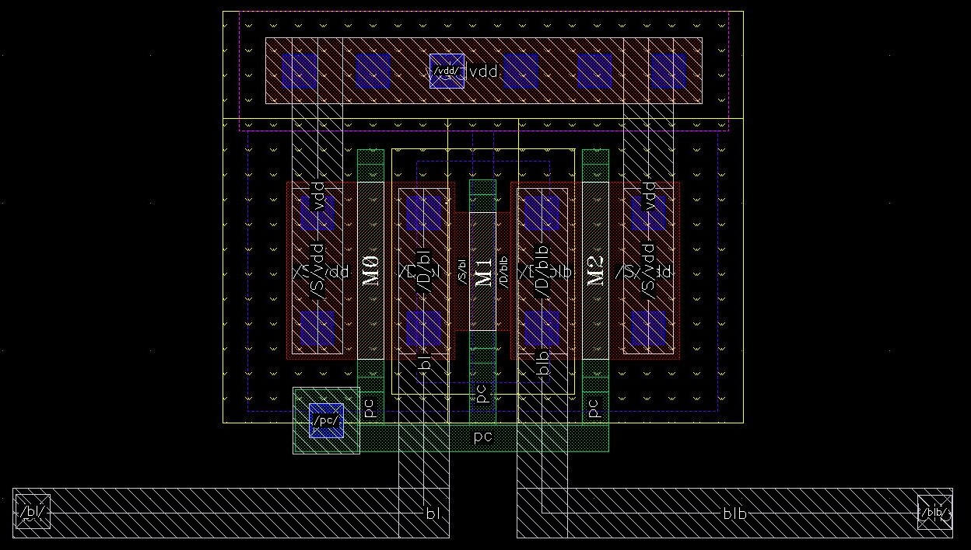
Fig 32. 7T SRAM Layout
Fig 33. 4x16 Decoder Layout

Slide 29
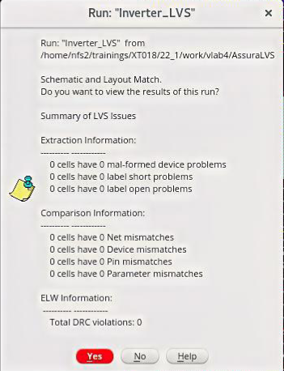
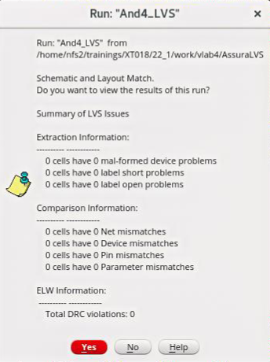
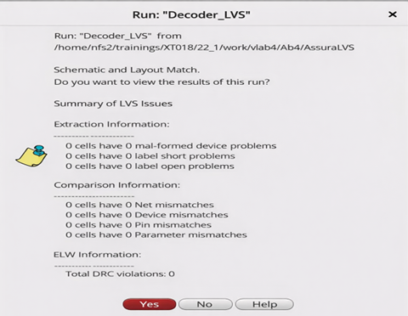
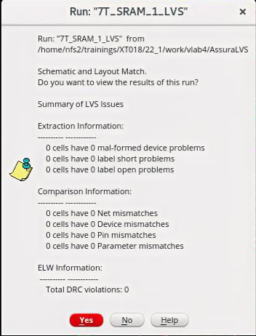
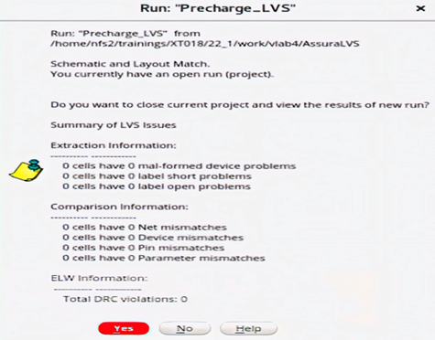
Fig 34. Inverter layout DRC and LVS check
Fig 35. 4-input AND Layout DRC and LVS check
Fig 36. Row decoder Layout DRC and LVS check
Fig 37. 7T SRAM Layout DRC and LVS check
Fig 38. Precharge cell Layout DRC and LVS check

Slide 30
Work Completed
Design and simulation of 6T SRAM cell.
Design of proposed 7T SRAM cell.
Functional verification of read and write operations.
Stability analysis (SNM) and power analysis of SRAM cells.
Design of peripheral circuits:
4×16 Row Decoder
Precharge Circuit
Write Driver
Sense Amplifier
Layout implementation of Inverter, 4-input AND gate, Row Decoder, 7T-SRAM cell and Precharge cell.
DRC and LVS verification of implemented layouts.
Work in Progress
Layout design of remaining SRAM peripheral circuits.
Integration of SRAM cells with decoder and bitline circuitry.
Optimization of array structure and routing.
Future Work
Complete 16 × 8 SRAM array layout implementation.
Perform DRC and LVS verification for full SRAM array.
Conduct post-layout simulations for performance validation.
Evaluate power, stability and timing performance.

Slide 31
CONCLUSIONS
Designed and simulated 6T and proposed 7T SRAM cells using 180 nm XFAB technology in Cadence Virtuoso.
Functional verification confirmed correct read, write, and hold operations of the SRAM cells.
Stability analysis using butterfly curve and SNM evaluation shows that the 7T SRAM cell provides improved stability compared to the conventional 6T cell.
The additional transistor in the 7T architecture helps reduce read disturbance and leakage current, improving reliability.
Peripheral circuits including row decoder, precharge circuit, write driver, and sense amplifier were successfully designed and verified.
Basic layout implementation and DRC/LVS verification of key digital blocks have been completed.
The next phase focuses on complete 16×8 SRAM array integration, layout implementation, and post-layout analysis.

Slide 32
REFERENCES
[1] E. Seevinck, F. J. List, and J. Lohstroh, “Static-noise margin analysis of MOS SRAM cells,” IEEE Journal of Solid-State Circuits, vol. 22, no. 5, pp. 748–754, Oct. 1987.
[2] S. M. Kang and Y. Leblebici, CMOS Digital Integrated Circuits: Analysis and Design, 3rd ed. New York, NY, USA: McGraw-Hill, 2003.
[3] N. H. E. Weste and D. Harris, CMOS VLSI Design: A Circuits and Systems Perspective, 4th ed. Boston, MA, USA: Addison-Wesley, 2011.
[4] B. Razavi, Design of Analog CMOS Integrated Circuits, 2nd ed. New York, NY, USA: McGraw-Hill, 2012.
[5] Y. Zhang, J. Wang, and Y. Li, “A 7T SRAM cell design for improved stability and low leakage,” IEEE Transactions on Very Large Scale Integration (VLSI) Systems, vol. 18, no. 3, pp. 484–488, Mar. 2010.
[6] R. Bisht and A. Pranav, “Design of 16×16 SRAM array using 7T SRAM cell for low power applications,” Journal of Graphic Era University, vol. 5, no. 2, pp. 58–68, 2017.
[7] V. Saxena, SRAM Static Characterization, Department of Electrical and Computer Engineering, Boise State University, Boise, ID, USA, Lecture slides, 2016.
[8] D. Balobas and N. Konofaos, “Design and evaluation of 6T SRAM layout designs at modern nanoscale CMOS processes,” in Proc. 4th International Conf. on Modern Circuits and Systems Technologies (MOCAST), 2015.

Slide 33
Thank You
any questions ?

